Slide 1



Flipkart GRiD 5.0 - Software Development Track
Customer-Centered E-commerce Product Recommendations
SRM Institute of Science and Technology, Kattankulathur,,Chennai
Batch : 2025

Slide 2




J926
Tailored e-commerce product suggestions prioritize customer preferences, enhancing their shopping experience and satisfaction with personalized recommendations.
Ishit Arhatia
Parth Agarwal
Bryan Abraham
"Developing customer-centered e-commerce recommendations was a gratifying experience. Crafting personalized solutions to enhance shopping satisfaction felt rewarding, fostering deeper engagement and value."
"Working on customer-centered e-commerce product recommendations was an exciting journey. Crafting personalized solutions to elevate shopping experiences felt both challenging and fulfilling, driving innovation in the e-commerce space."
"While working on customer-centered e-commerce product recommendations, I found it fulfilling to create tailored solutions that enhance the shopping journey, bringing satisfaction and innovation to the forefront."

Slide 3


Deliverables
Our Vision
Our vision is to revolutionize e-commerce by placing customers at the heart of the experience. Through data-driven insights and advanced algorithms, we aim to offer personalized product recommendations that delight and enrich every shopper's journey
Our Code
https://github.com/parthgarg123/flipkart_personalized_prod_recommendation/blob/main/Untitled3_(1).ipynbo

Slide 4
Deployments
Cross-Sell and Upsell
Trend-Based
Social Proof Recommendations
Dynamic Pricing
Replinishment
Suggesting complementary or upgraded products during the shopping process to increase the average order value.
Providing recommendations aligned with seasons, holidays, or current fashion trends.
Offering discounts or pricing adjustments based on customer behavior and purchase history..
Reminding customers to repurchase consumable or perishable products they've bought in the past.
Displaying products that are popular or highly rated among a customer's peers.

Slide 5



APPROACHES
Similarity based Collaborative filtering
Rank Based Product Recommendation
Model based Collaborative filtering

Slide 6


Scope
Personalization
One can explore more advanced recommendation algorithms like collaborative filtering, content-based filtering, or hybrid methods to enhance the personalization aspect.
Real Time Recommendations
If the system isn't already doing so, you can work on making recommendations in real-time. This could involve incorporating user behavior and preferences as they change over time.
Multimodal Data
Integrating other types of data, such as images and reviews, can enhance recommendation accuracy. Future developments might involve using deep learning techniques for image-based recommendations.
Scalability
Scaling the system to handle a larger user base and a more extensive product catalog. This might involve optimizing algorithms and using distributed computing resources
A/B testing
Implementing and fine-tuning recommendation algorithms through A/B testing to understand their impact on user engagement and conversion rates.

Slide 7





Limitations
Challenges include data privacy concerns, algorithmic bias, overfitting, and scalability issues. Striking a balance between personalization and serendipity while ensuring ethical compliance is pivotal.
Cold Start Problem
Data Quality
Recommender systems may struggle to provide accurate recommendations for new users or new products because they lack historical data
The quality of recommendations heavily depends on the quality of the data. Inaccurate or biased data can lead to poor recommendations.
Privacy
Diversity
Collecting and storing user data for recommendation can raise privacy concerns. Ensuring data privacy and compliance with regulations like GDPR is essential.
Recommender systems can sometimes create filter bubbles, where users are only exposed to a narrow range of products. Ensuring diversity in recommendations can be a challenge.

Slide 8
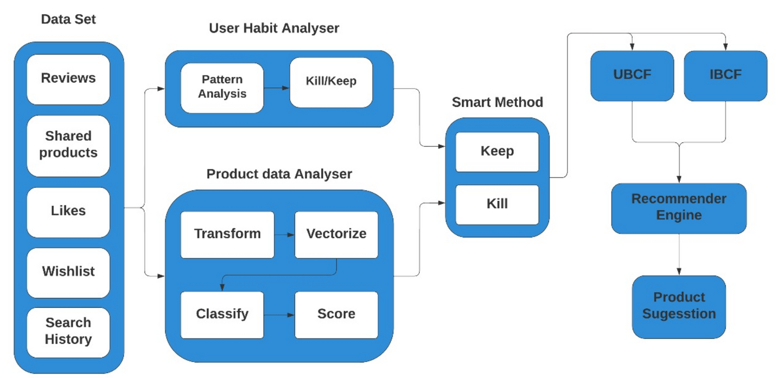
Block Diagram

Slide 9

Thank You

